Slide 1

WIPRO NGA PROGRAM– NMS BATCH
CAPSTONE PROJECT PRESENTATION : 24 JULY 2024.
PROJECT TITLE– NETWORK MONITORING MICROSERVICES
PRESENTED BY:
1.Chinthalaiahgari Sudheer Reddy.
2.Bhargavi Pidugu.
3.Reddy Mounika.
4.Chellem Vikhil.
5. B V Venkata Satya Sainadh
Ganesh Kandala.
6. Siva Krishna Bezawada.
7. Pasam Puneeth.
8.Raja Ambedkar Bandili.
9.Deva Kumar Kolluru.
10.Datla Lahari Sai Likhitha.
www.rpsconsulting.in

Slide 2
OVERVIEW
Introduction.
Project Objectives.
Initial Setup And Development.
Dependencies.
SNMP Client Implementation.
Telemetry Client Implementation.
Data Processing.
Data Aggregation.
Testing And Integration.
Conclusion.

Slide 3

INTRODUCTION
Network Monitoring Microservices designed to monitor the health and performance of network devices.
Developing a Network Monitoring Microservice in Java, focusing on data collection via SNMP and Telemetry, involves several key components: Data collection agents ,Data processing ,Data storage, User Interface for monitoring and Alerts.
Network devices such as routers, switches, firewalls, and servers are critical components of any IT
infrastructure. Monitoring these devices is essential for:
Ensuring network stability and uptime.
Identifying and resolving issues quickly.
Optimizing performance.
Security Management.
Importance of Monitoring is crucial to ensure network Reliability , Performances and Security.
2024 - RPS Consulting all rights reserved

Slide 4
OBJECTIVE
The Objective of network monitoring in a microservices project is to ensure the reliability, availability, and performance of the entire system.
Using SNMP and Streaming Telemetry to gather data on network device health and performances.
Monitor specific performance metrics for each microservice including : Latency,
Throughput ,Error Rates, Resource Utilization.
Testing and Integration is to ensure reliability and effectiveness of the monitoring solution through comprehensive testing and integration.
2024 - RPS Consulting all rights reserved

Slide 5
INITIAL SETUP & DEVELOPMENT
Java Development Kit (JDK)- Essential for developing, Java applications.
Maven or Gradle –To manage project dependency management and build processes.
IDE (Eclipse) –Development environments providing tools for coding, debugging and project management.
Git for version control – For tracking changes and collaborating.
SNMP library (e.g., SNMP4J)-Library to interact with SNMP devices.
Telemetry library (e.g., Open Telemetry) - For collecting and exporting telemetry data.
2024 - RPS Consulting all rights reserved

Slide 6
DEPENDENCIES
xml Copy code Add dependencies for SNMP4J and OpenTelemetry in the pom.xml (for Maven)
SNMP:
<dependency>
<groupId>org.snmp4j</groupId> <artifactId>snmp4j</artifactId> <version>2.8.3</version>
</dependency>
TELEMETRY:
<dependency>
<groupId>io.opentelemetry</groupId> <artifactId>opentelemetry-api</artifactId> <version>1.5.0</version>
</dependency>
2024 - RPS Consulting all rights reserved

Slide 7
SNMP
Abbreviation: SNMP stands for Simple Network Management Protocol.
Definition:
SNMP (Simple Network Management Protocol) is a widely used protocol for managing and monitoring network devices such as routers, switches, servers, workstations, printers, and more. It allows network administrators to manage network performance, find and solve network problems, and plan for network growth.
Purpose: It is used for monitoring and managing network devices on an IP network.
Function:
SNMP collects and organizes information about managed devices on IP networks and modifies that information to change device behavior.
2024 - RPS Consulting all rights reserved

Slide 8
SNMP COMPONENTS
1.SNMP Manager: The system used to control and monitor the activities of network devices using SNMP.
2.SNMP Agent: The software that resides on a network device to collect, store, and send management information.
3.Management Information Base (MIB): A database or collection of information organized hierarchically. It includes the definitions of all the manageable features of the device.
2024 - RPS Consulting all rights reserved

Slide 9
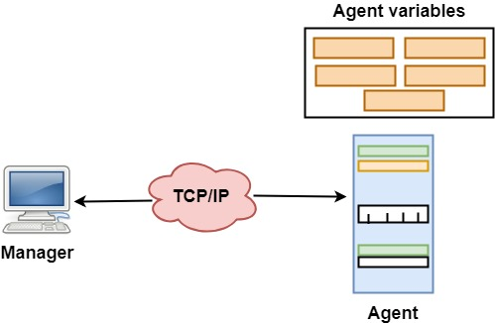
SNMP WORKS
2024 - RPS Consulting all rights reserved

Slide 10
SNMP OPERATIONS
GET:
Function: Retrieve one or more values from an agent.
Use Case: Monitor device status, such as current CPU load.
2.SET:
Function: Modify the value of one or more variables on an agent.
Use Case: Change configuration settings on a network device.
3.TRAP:
Function: An unsolicited message from an agent to the manager.
Use Case: Notify the manager about significant events.
2024 - RPS Consulting all rights reserved

Slide 11
SNMP VERSIONS
SNMPv1:
The original version with basic features and limited security.
2.SNMPv2c:
Introduced improved performance and security features, but still uses community-based security.
3.SNMPv3:
Adds strong security and encryption, ensuring data integrity and confidentiality.
2024 - RPS Consulting all rights reserved

Slide 12
SNMP USE CASES
Network Monitoring: Track the health and performance of network devices. Continuously monitor metrics such as CPU load, memory usage, bandwidth, and device availability
Fault Management: Receive alerts and diagnose issues quickly. This allows network administrators to promptly identify and resolve faults, minimizing downtime.
Performance Management: Optimize network efficiency by analyzing usage patterns. This information helps in identifying bottlenecks, and improving overall network performance.
Configuration Management: Automate the configuration of network devices. This automation reduces manual effort and speeds up deployment processes.
2024 - RPS Consulting all rights reserved

Slide 13
SNMP CLIENT OUTCOME
When we are going to run this code and call the getSystemdescription method with a valid Community Target instance, we will get the system description of the target SNMP device.
The system description typically contains information about the device's operating system, version, and other relevant details.
2024 - RPS Consulting all rights reserved

Slide 14
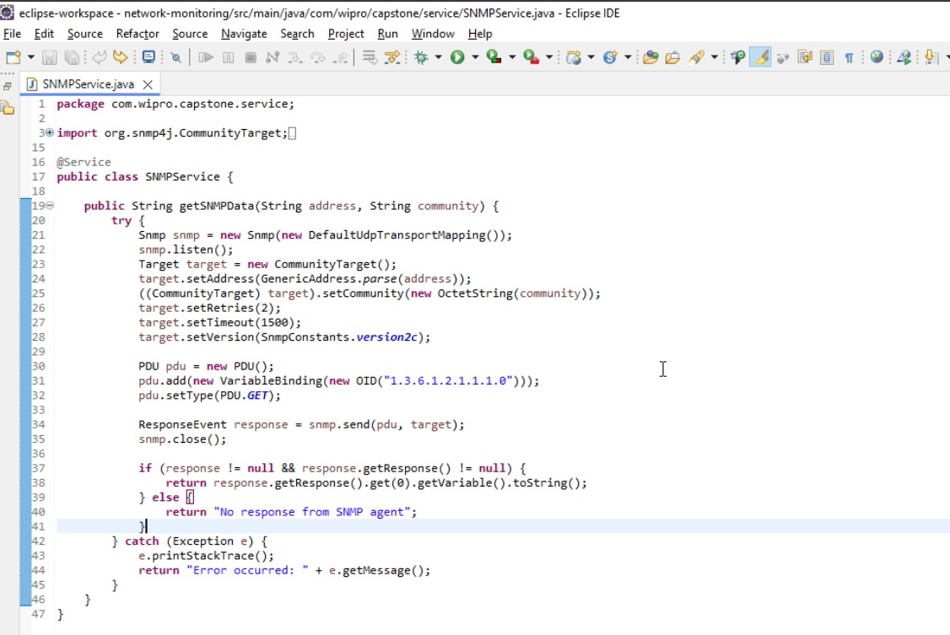
PROGRAM
Slide details here
2024 - RPS Consulting all rights reserved

Slide 15
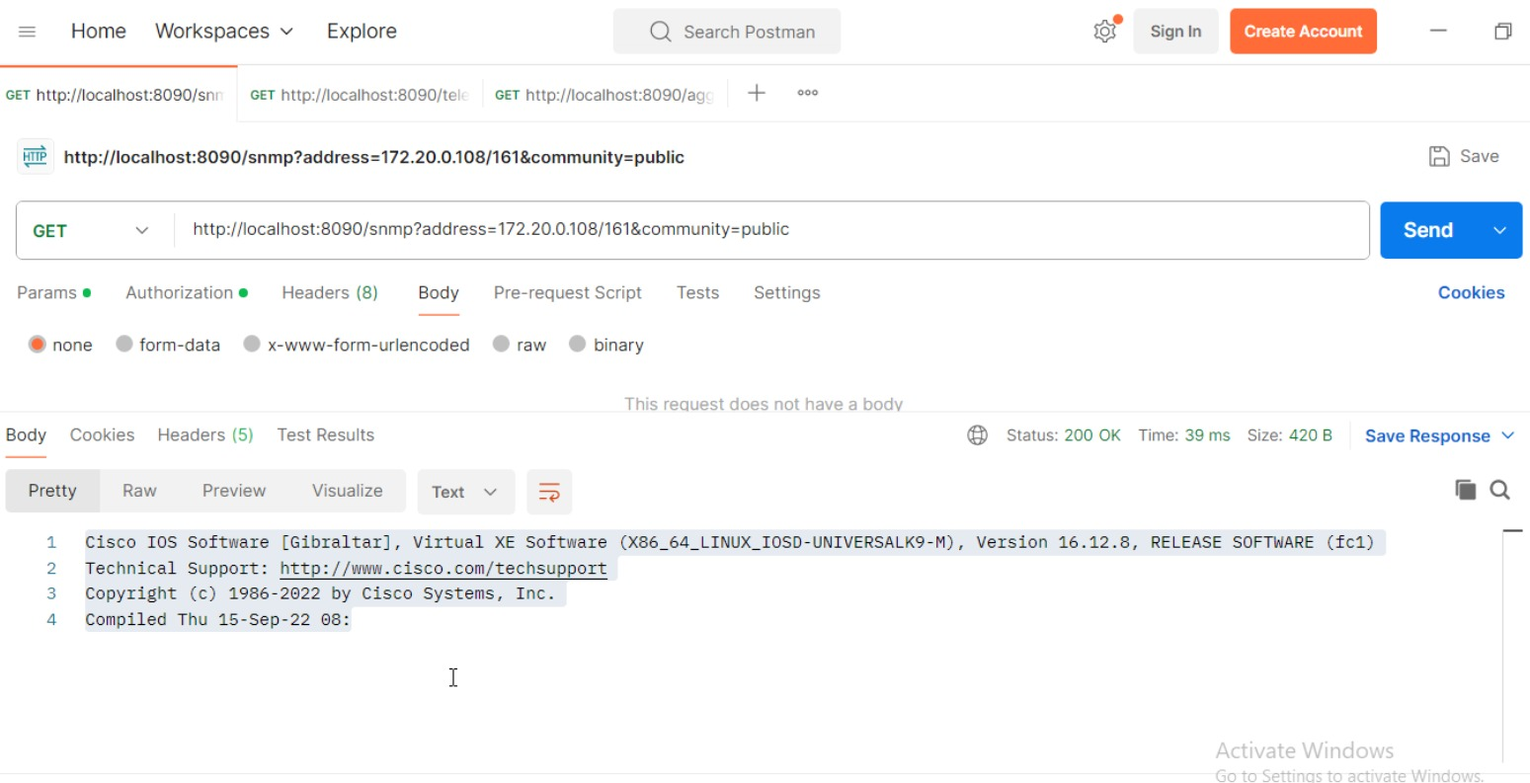
OUTPUT
2024 - RPS Consulting all rights reserved

Slide 16
STREAMING TELEMETRY
Definition:
Streaming Telemetry is a modern approach to network monitoring and management, offering real-time data collection and analysis. It addresses the limitations of traditional polling-based methods like SNMP, providing more efficient and scalable solutions for today's complex networks.
Purpose:
Provides continuous, high-frequency data streams for monitoring and analysis.
Function:
Uses push-based mechanisms to send telemetry data from devices to collectors, eliminating the need for constant polling.
2024 - RPS Consulting all rights reserved

Slide 17
TELEMETRY COMPONENTS
Telemetry Agent:
The Telemetry Agent is embedded within Network Devices (like Routers or Switches).It‘s primary role is to collect data from the devices and various components end systems. Integrated in devices, responsible for data collection.
Telemetry Collector:
Telemetry collector acts as a central hub for receiving telemetry data from multiple agent. Receives, processes, and stores telemetry data.
2024 - RPS Consulting all rights reserved

Slide 18
TELEMETRY OPERATIONS
Subscription:
Function: Define what data to collect and the frequency of updates.
Use Case: Monitor specific metrics such as interface statistics or CPU usage.
Encoding:
Function: Format data for efficient transmission (e.g., JSON, XML).
Use Case: Ensure compatibility and ease of processing by collectors.
3.Transport:
Function: Use protocols like gRPC or HTTP/2 for reliable data delivery.
Use Case: Ensure low-latency, high-throughput data transfer.
2024 - RPS Consulting all rights reserved

Slide 19
TELEMETRY WORKS
Telemetry Agents and Collectors:
Agent: Embedded in network devices, collects and sends data.
Collector: A system that receives, stores, and analyzes the streamed data.
2.Communication:
Uses data models and protocols like gRPC, NETCONF, and JSON.
Streams data continuously, providing near real-time insights.
2024 - RPS Consulting all rights reserved

Slide 20
ADVANTAGES OF STREAMING TELEMETRY
Real-Time Monitoring:
Provides immediate insights into network performance and health.
Scalability:
Handles large volumes of data from numerous devices efficiently.
Reduced Overhead:
Minimizes the load on network devices by avoiding constant polling.
Granular Data:
Offers fine-grained, high-frequency data for detailed analysis.
2024 - RPS Consulting all rights reserved

Slide 21
TELEMETRY USECASES
Network Monitoring:
Description: Track the health and performance of network devices.
Details: Continuously monitor metrics such as CPU load, memory usage, bandwidth, and device availability. This helps in early detection of potential issues and ensures the network operates smoothly.
Fault Management:
Description: Receive alerts and diagnose issues quickly.
Details: Streaming telemetry provides real-time alerts and detailed data for prompt issue identification and resolution, reducing downtime.
2024 - RPS Consulting all rights reserved

Slide 22
TELEMETRY OUTCOME
The Telemetry Client class is designed to report CPU usage metrics using the Open Telemetry API. In this code, an instance of Telemetry Client is created, and then the reportCpuUsage method is called with a CPU usage value of 75.5%. This value is added to the cpuUsageCounter, effectively recording the CPU usage metric.
The constructor initializes a Meter instance from the global Open Telemetry instance, named "network-monitoring“
The reportCpuUsage method allows reporting of CPU usage by adding the specified usage value to the cpuUsageCounter
2024 - RPS Consulting all rights reserved

Slide 23
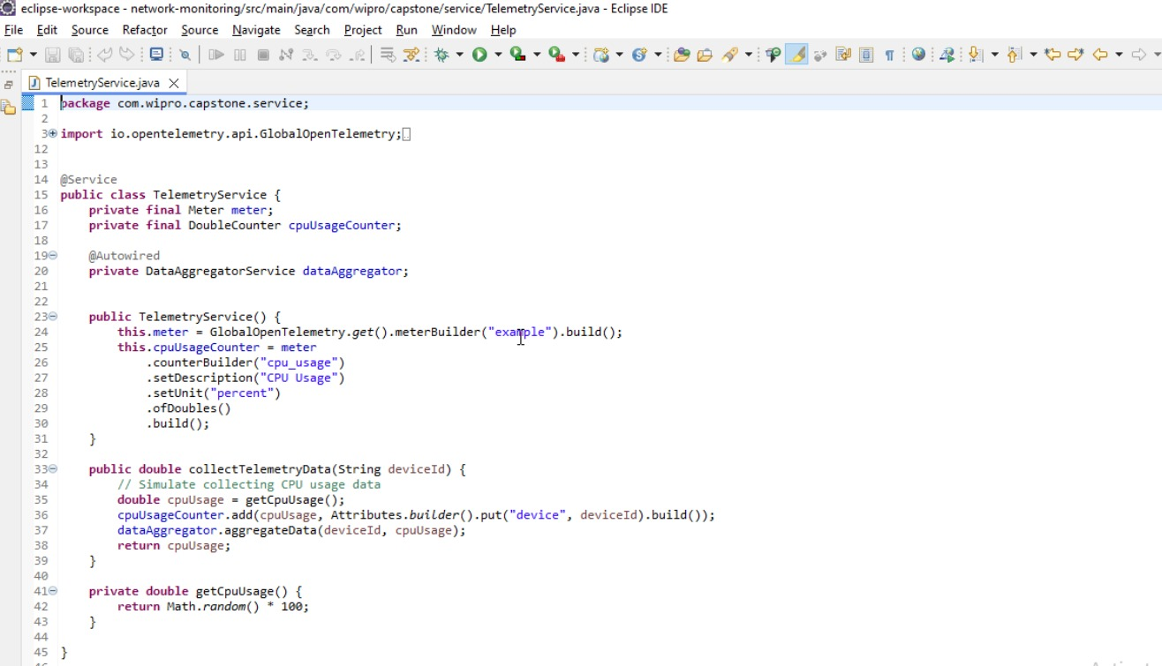
PROGRAM
Slide details here
2024 - RPS Consulting all rights reserved

Slide 24
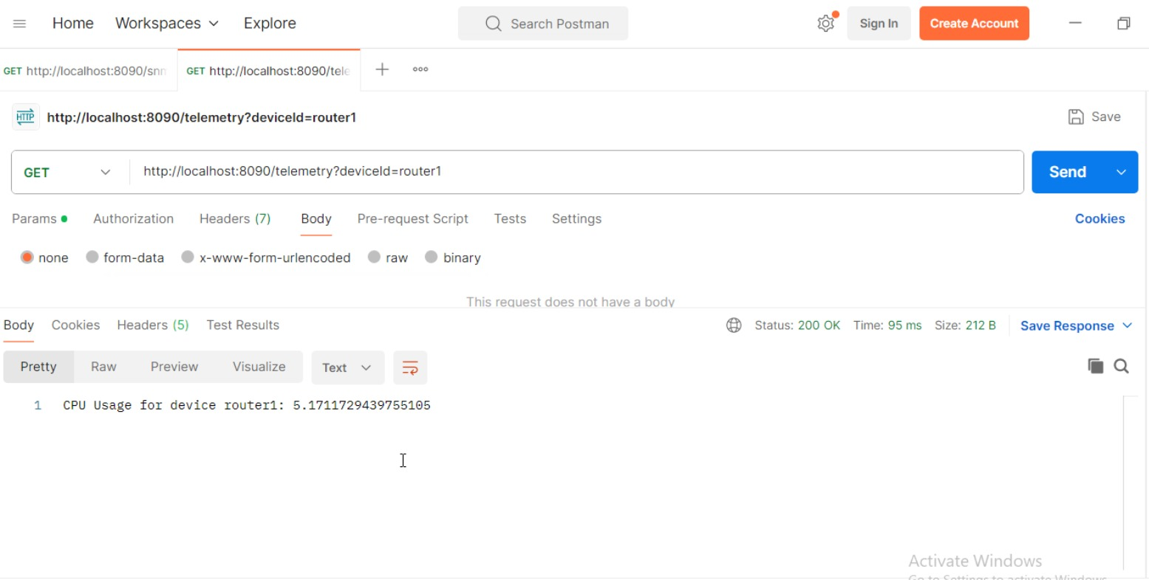
OUTPUT
2024 - RPS Consulting all rights reserved

Slide 25
DATA PROCESSING
Collection:
Definition: Gathering raw data from various sources such as network devices, sensors, or applications.
Example: Collecting SNMP data, streaming telemetry data via gRPC, or logs from network devices.
Ingestion:
Definition: Transferring the collected data to a central system for further processing.
Example: Using data ingestion tools like Apache Kafka, Fluentd, or Logstash to transfer data to processing systems.
2024 - RPS Consulting all rights reserved

Slide 26
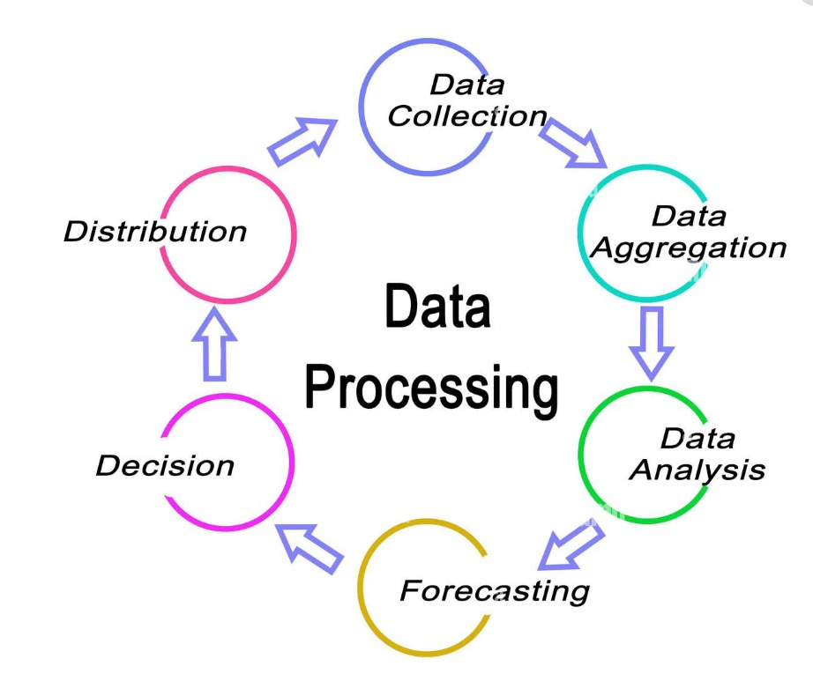
FLOWCHART
2024 - RPS Consulting all rights reserved

Slide 27
DATA AGGREGATION
Purpose of Data Aggregation:
1.Simplification: Reduces the complexity of data by summarizing it.
2.Scalability: Enables handling large volumes of data by consolidating it.
3.Insights: Provides high-level insights that are useful for decision making.
Types of Data Aggregation:
Summarization:
Aggregating data to provide summary statistics such as sum, average, minimum, and maximum.
Example: Calculating the average CPU usage of a router over a 24-hour period.
2024 - RPS Consulting all rights reserved

Slide 28
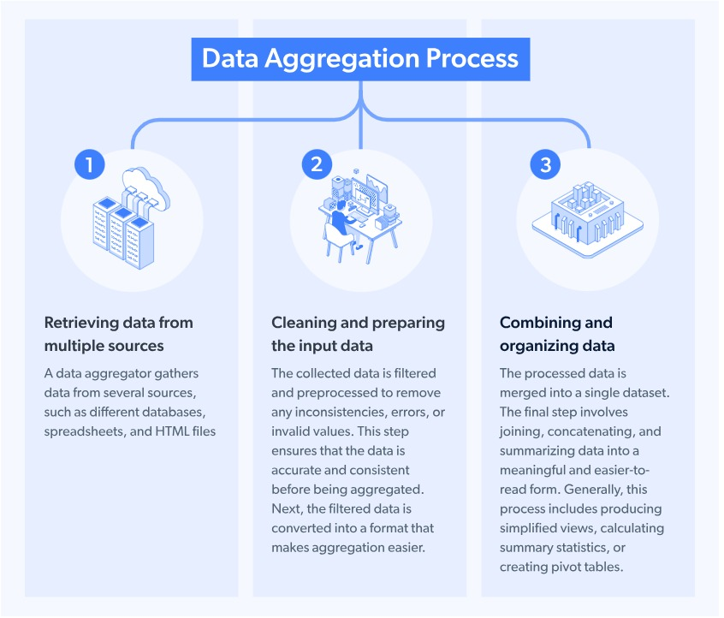
FLOWCHART
2024 - RPS Consulting all rights reserved

Slide 29
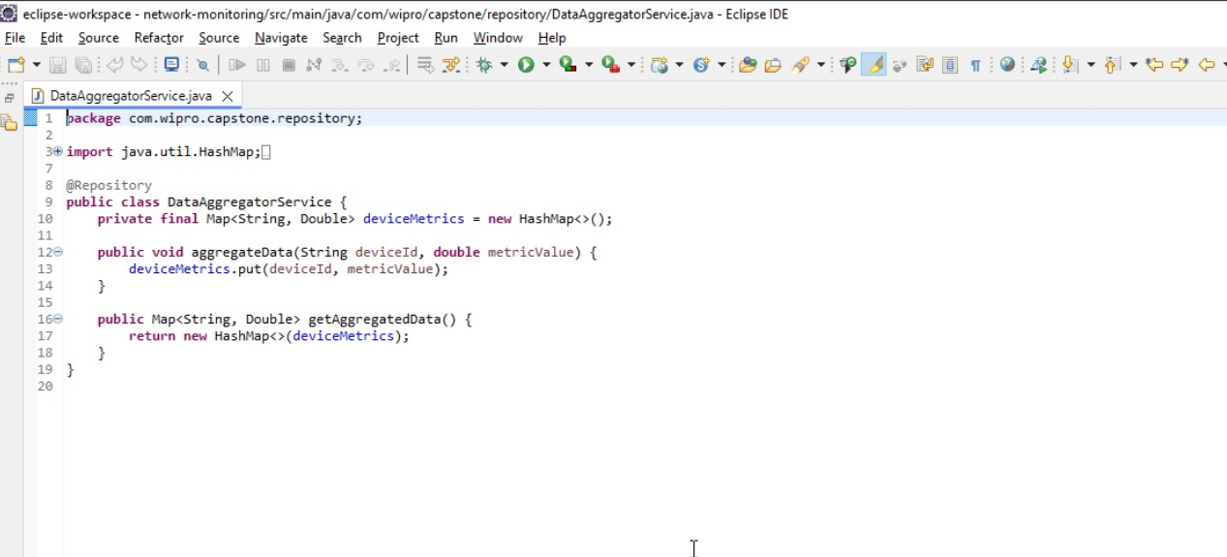
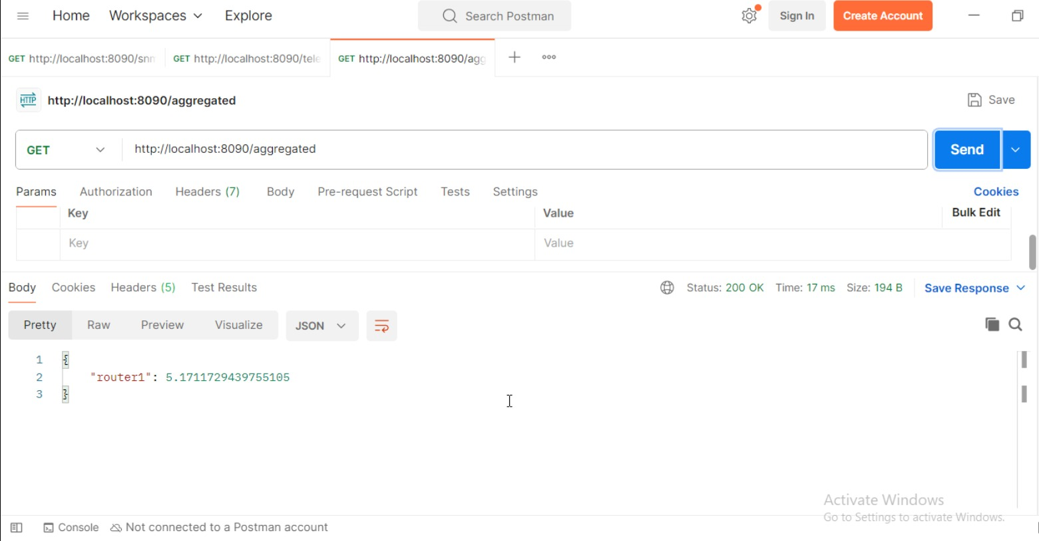
PROGRAM AND OUTPUT
2024 - RPS Consulting all rights reserved

Slide 30
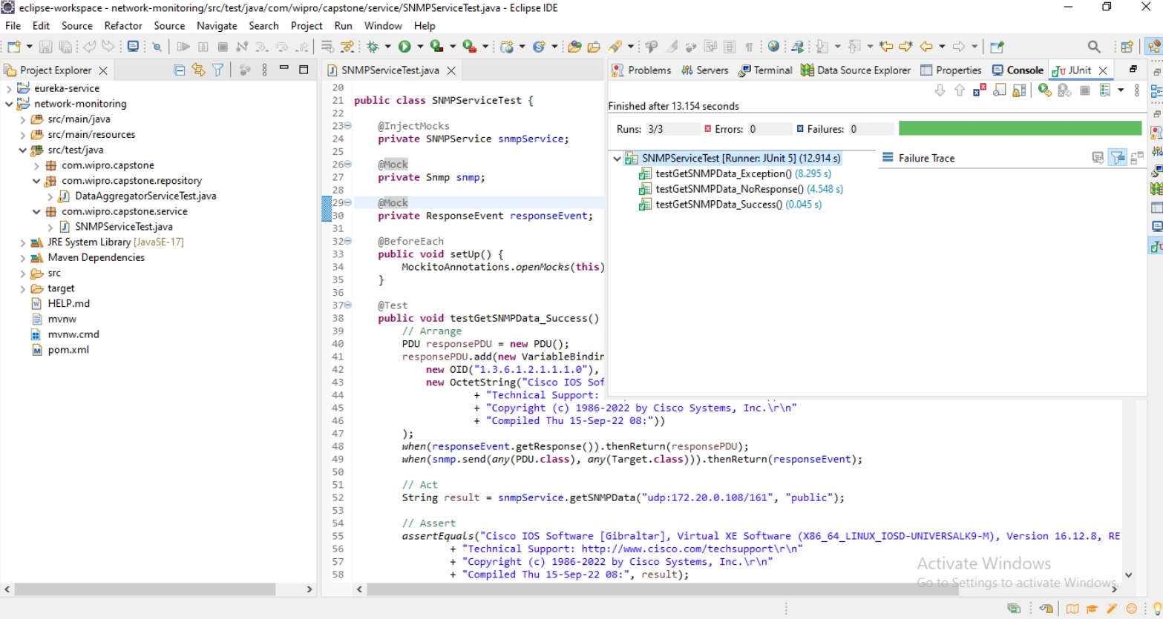
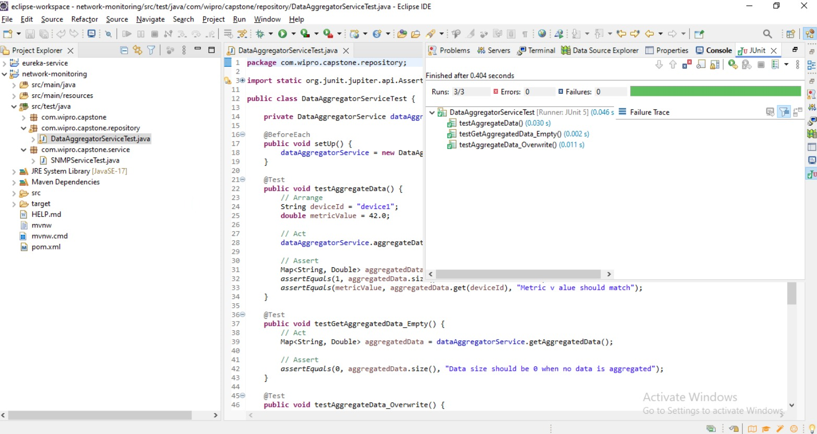
TESTING AND INTEGRATION
UNIT TESTING:
Test individual components in isolation to verify their correctness.
Write unit tests for SNMP and Telemetry data collection methods using Junit.
2024 - RPS Consulting all rights reserved

Slide 31
CONCLUSION
By doing this project, we got a broader idea about snmp4j and openTelemetry-api. SNMP is used to communicate to SNMP client by using commands like get. Whereas, telemetry is used to present various type of data of network device. Thus, these both dependencies are used to create a microservice in java.
We have successfully develop the Network Monitoring Microservice, ensuring it monitors the health and performance of network devices using SNMP and streaming telemetry. The integration with data processing and aggregation for real-time visibility and comprehensive testing will ensure a reliable and effective solution for network monitoring.
2024 - RPS Consulting all rights reserved

Slide 32
Thank You!!!
2024 - RPS Consulting all rights reserved

